Slide 1
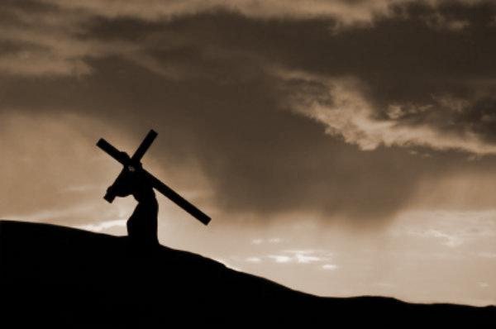
Philippians 2:5-11
The Attitude of Christ
Preached by Dan Bridges Amman International Church, Jordan (AmmanChurch.org) Uploaded by Dr. Rick Griffith • Jordan Evangelical Theological Seminary Files in many languages for free download at BibleStudyDownloads.org

Slide 2
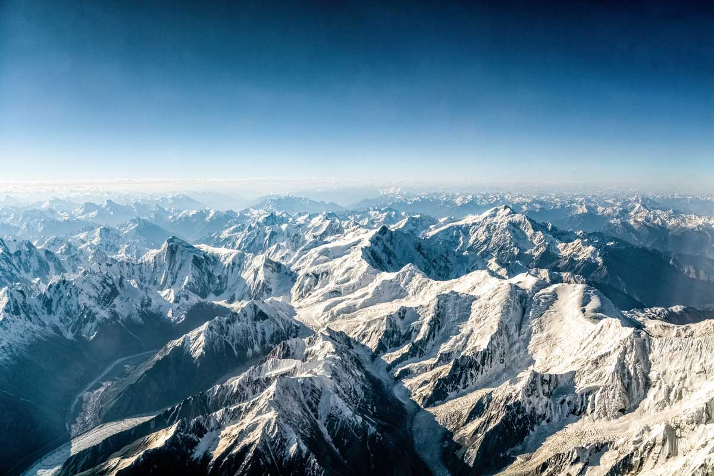
The Himalayas

Slide 3
Even the Himalayas have some peaks that stand out above others!
Notes:
That’s what our passage for today is like! It’s as if the curtains of heaven were pulled back for a moment and we get a brief glimpse of what God is like. We see how the members of the Trinity relate to each other, defer to each other and honor each other. We see the very mind of our Lord Jesus Christ and have a window into how he thinks!

Slide 4
Lives Worthy of the Gospel (1:27)
How we relate with the unbelieving world (1:27-30)
How we relate with believers (2:1-4)

Slide 5
Relating with Our Fellow Believers
A call to unity!
“Make my joy complete by being like-minded, having the same love, being one in spirit and purpose.” Philippians 2:2

Slide 6
Relating with Our Fellow Believers
Do nothing out of selfish ambition or vain conceit, but in humility consider others better than yourselves (2:3)
Humility!
Notes:
Two key points that especially relate to our passage for today…

Slide 7
Relating with Our Fellow Believers
Let each of you look not only to your own interests, but also to the interests of others (2:4)
Selflessness!

Slide 8
Purpose of Philippians 2:5-11
Paul wanted to show how Jesus himself exemplified these attitudes:
Humility
Selflessness

Slide 9
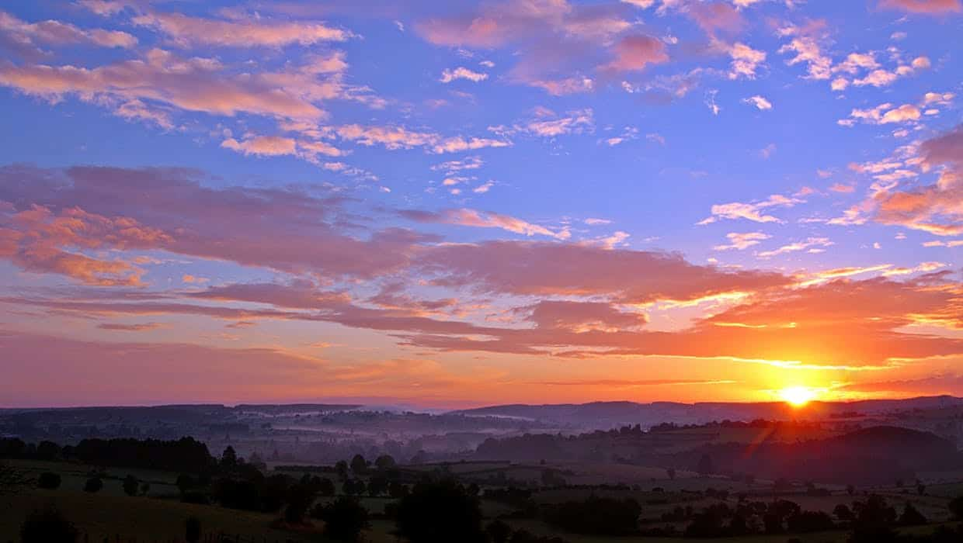
⁵ Your attitude should be like that of Christ Jesus ⁶ Who, being in very nature God, did not consider equality with God something to be grasped, ⁷ but made himself nothing, taking the very nature of a servant, being made in human likeness. ⁸ And being found in appearance as a man, he humbled himself by becoming obedient to death — even death on a cross!
Philippians 2:5-8

Slide 10
⁹ Therefore God exalted him to the highest place and gave him the name that is above every name, ¹⁰ that at the name of Jesus every knee should bow, in heaven and on earth and under the earth, ¹¹ and every tongue acknowledge that Jesus Christ is Lord, to the glory of God the Father.
Philippians 2:9-11

Slide 11
⁵ Your attitude should be like that of Christ Jesus ⁶ Who, being in very nature God, did not consider equality with God something to be grasped, ⁷ but made himself nothing, taking the very nature of a servant, being made in human likeness. ⁸ And being found in appearance as a man, he humbled himself by becoming obedient to death — even death on a cross!
Philippians 2:5-8

Slide 12
Humility & Self-Forgetfulness
How did Jesus Show these Attitudes?
Three Sets of Circumstances:
Pre-incarnate glory
Incarnate humiliation
Incarnate exaltation
Incarnate:
Having a human body

Slide 13
Jesus’ Pre-incarnate Glory
⁵ Your attitude should be like that of Christ Jesus ⁶ Who, being in very nature God, did not consider equality with God something to be grasped, ⁷ but made himself nothing, taking the very nature of a servant, being made in human likeness. ⁸ And being found in appearance as a man, he humbled himself by becoming obedient to death — even death on a cross!
Greek: morphḗ
Morphḗ does not mean "shape."
The outward expression (possibly visible) of an inner essence.
Essential essence that never changes
Notes:
We don’t have an identical word in English. The ones that come close are form or nature.

Slide 14
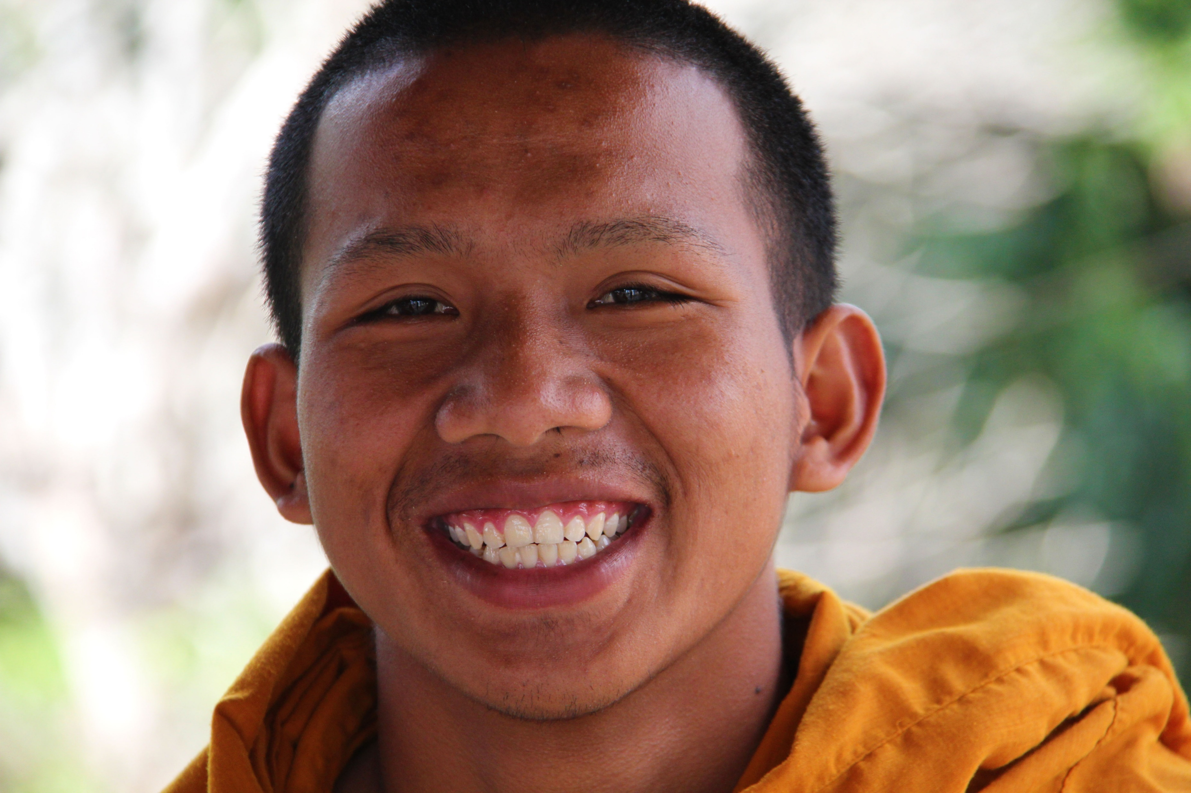
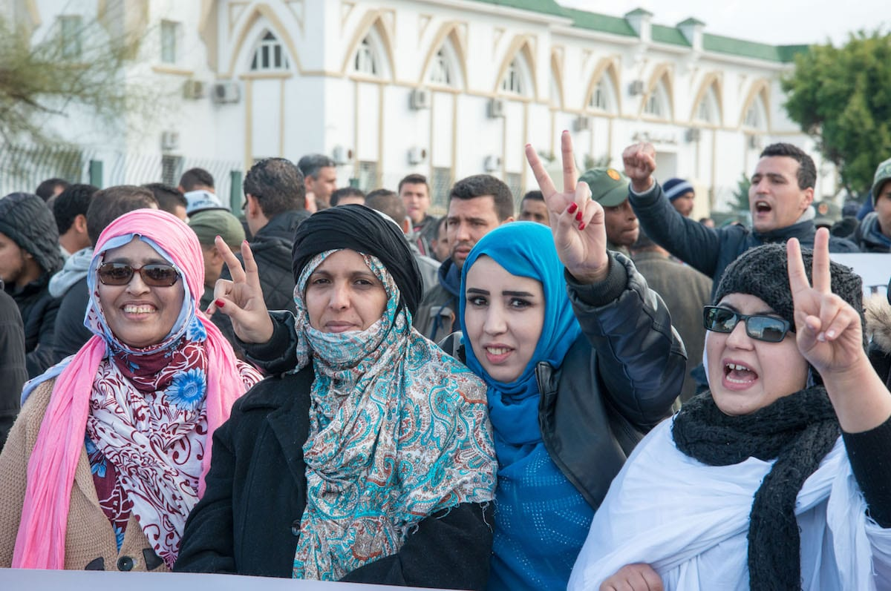
The “morphḗ” of a Human
This Photo by Unknown Author is licensed under CC BY-SA-NC

Slide 15
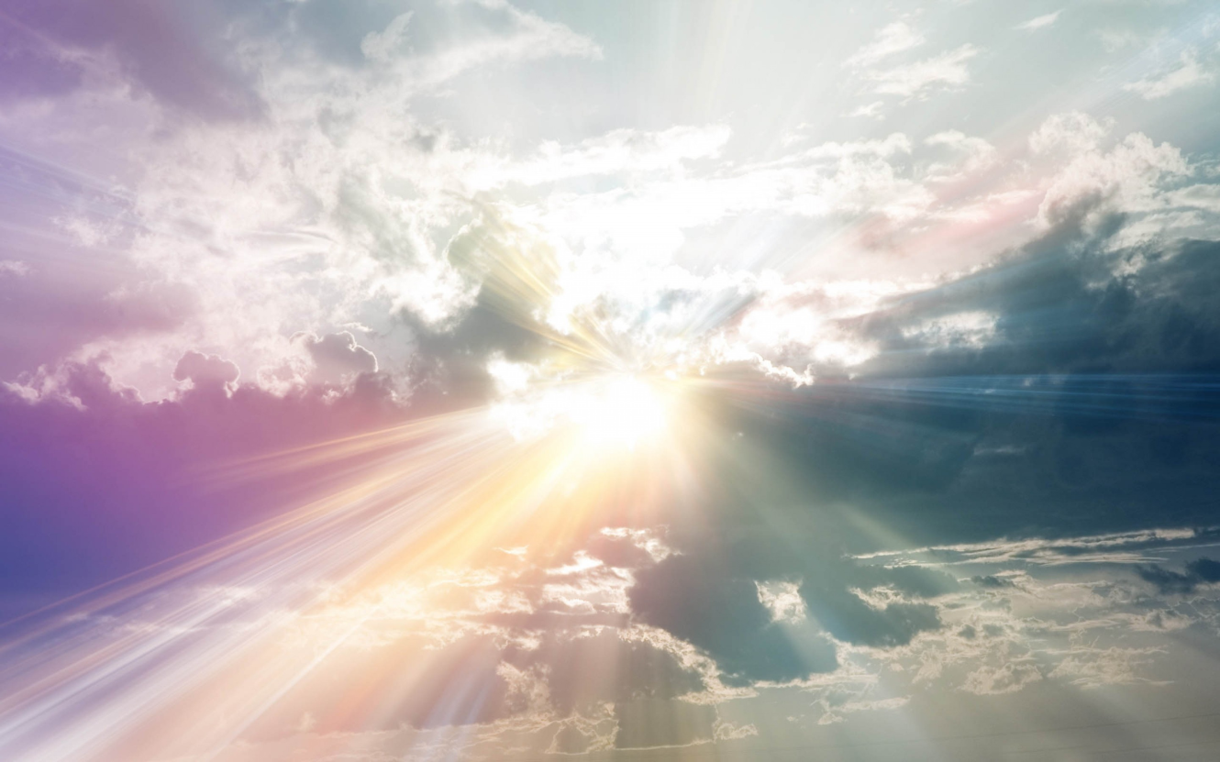
What did it mean for Jesus to be in very nature God?
(i.e. the essential essence of God)
Eternal, Immortal
Creator of all things
Blinding glory, dwells in “unapproachable light”
Omnipotent – all-powerful
Omniscient – all-knowing
Omni-present – present everywhere
Notes:
1 Timothy 6:16 “unapproachable light”

Slide 16
What did it mean for Jesus to be in very nature God?
(i.e. the essential essence of God)
³⁹ …Isaiah said, ⁴⁰ “He has blinded their eyes and hardened their heart, lest they see with their eyes, and understand with their heart, and turn, and I would heal them.”
⁴¹ Isaiah said these things because he saw his glory and spoke of him. ⁴² Nevertheless, many even of the authorities believed in him, but for fear of the Pharisees they did not confess it, so that they would not be put out of the synagogue… John 12:39-42
Notes:
Who’s glory does it say Isaiah saw?

Slide 17
What did it mean for Jesus to be in very nature God?
(i.e. the essential essence of God)
³⁹ …Isaiah said, ⁴⁰ “He has blinded their eyes and hardened their heart, lest they see with their eyes, and understand with their heart, and turn, and I would heal them.”
⁴¹ Isaiah said these things because he saw his glory and spoke of him. ⁴² Nevertheless, many even of the authorities believed in him, but for fear of the Pharisees they did not confess it, so that they would not be put out of the synagogue… John 12:39-42
Notes:
Jesus’ glory! When?

Slide 18
What did it mean for Jesus to be in very nature God?
(i.e. the essential essence of God)
Adonai
¹ In the year that King Uzziah died I saw the Lord sitting upon a throne, high and lifted up; and the train of his robe filled the temple. ² Above him stood the seraphim. Each had six wings: with two he covered his face, and with two he covered his feet, and with two he flew. ³ And one called to another and said:
“Holy, holy, holy is the LORD of hosts;
the whole earth is full of his glory!” Isaiah 6:1-3
Yahweh

Slide 19
Jesus’ Pre-incarnate Glory
⁵ Your attitude should be like that of Christ Jesus ⁶ Who, being in very nature God, did not consider equality with God something to be grasped, ⁷ but made himself nothing, taking the very nature of a servant, being made in human likeness. ⁸ And being found in appearance as a man, he humbled himself by becoming obedient to death — even death on a cross!
Being (In original Greek):
This verb speaks of something in the past
It also continues into the present (not was!)
(Jesus did not give up his deity when he
came to earth.)

Slide 20
Jesus’ Pre-incarnate Glory
⁵ Your attitude should be like that of Christ Jesus ⁶ Who, being in very nature God, did not consider equality with God something to be grasped, ⁷ but made himself nothing, taking the very nature of a servant, being made in human likeness. ⁸ And being found in appearance as a man, he humbled himself by becoming obedient to death — even death on a cross!
Jesus was and could never cease to be God
Jesus was willing to waive his rightful claim to the divine expression

Slide 21
Jesus’ Pre-incarnate Glory
The attitude of people:
Power is something to be grasped for
We are not God – but see equality with him as something to be grasped!
The attitude of Christ:
Position is not something to be seized upon for his own advantage, but to be used for the good of his Father and his creation!
Notes:
Every time we choose to disobey God, we’re trying to be God – believing that we know better!

Slide 22
Humility & Self-Forgetfulness
How did Jesus Show these Characteristics?
Three Sets of Circumstances:
Pre-incarnate glory
Incarnate humiliation
Incarnate exaltation
Incarnate: Having a human body

Slide 23
Jesus’ Incarnate Humiliation
⁵ Your attitude should be like that of Christ Jesus ⁶ Who, being in very nature God, did not consider equality with God something to be grasped, ⁷ but made himself nothing, taking the very nature of a servant, being made in human likeness. ⁸ And being found in appearance as a man, he humbled himself by becoming obedient to death — even death on a cross!
Greek: morphḗ
Outward expression of an inner essence
Inner essence: a bond-servant!

Slide 24
Jesus as Man!
Expressed in Divine Glory
God’s
Divine
Essence
Expressed in Humble Servitude
Both are elements of God’s divine essence!

Slide 25
Pre-Incarnation Glory
Incarnate Humiliation
Heavenly Glory
(Isaiah 6:1-3)
Heavenly “body”
Heavenly riches
(2 Corinthians 8:9)
Unbroken favor of his Father
No beauty / majesty (Isaiah 53:1-3)
Weak, mortal human body
Poor
(2 Corinthians 8:9)
Wrath of God poured out on him

Slide 26
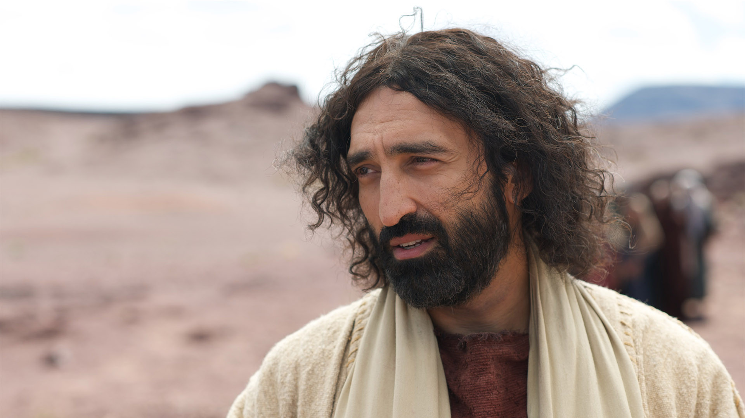
God anointed Jesus of Nazareth with the Holy Spirit and with power. He went about doing good and healing all who were oppressed by the devil, for God was with him.
Acts 10:38
All “God-like” acts were done in dependence on the power and presence of the Holy Spirit.

Slide 27
Jesus’ Incarnate Humiliation
“He was setting aside His legitimate and natural desires and prerogatives as Deity. The basic, natural desire and prerogative of Deity is that of being glorified. But when Deity sets these aside, it sets its desires aside, and setting its desires aside, it sets Self aside... Our Lord emptied himself of self!” Kenneth Wuest

Slide 28
Jesus’ Incarnate Humiliation
“He was setting aside His legitimate and natural desires and prerogatives as Deity. The basic, natural desire and prerogative of Deity is that of being glorified. But when Deity sets these aside, it sets its desires aside, and setting its desires aside, it sets Self aside... Our Lord emptied himself of self!” Kenneth Wuest

Slide 29
Bond-Servant to Whom?
His Father:
Behold, my servant shall act wisely; he shall be high and lifted up, and shall be exalted.
Isaiah 52:13
Mankind:
For even the Son of Man came not to be served but to serve, and to give his life as a ransom for many. Mark 10:45

Slide 30
Jesus’ Incarnate Humiliation
⁵ Your attitude should be like that of Christ Jesus ⁶ Who, being in very nature God, did not consider equality with God something to be grasped, ⁷ but made himself nothing, taking the very nature of a servant, being made in human likeness. ⁸ And being found in appearance as a man, he humbled himself by becoming obedient to death — even death on a cross!
The Humility of Limitless Obedience!
Obedience to the point of death
Humiliating death on a cross
Notes:
Death on a cross was reserved for slaves and outcasts
Some of us may feel that we have “emptied ourselves” to come here to Jordan. But the we get here and expect to be treated as people of privilege. Can we work under Jordanians? Do we only respect Jordanians who are like us?

Slide 31
Jesus’ Incarnate Humiliation
The attitude of people:
We strive for recognition
Our obedience is limited by what seems “reasonable”
The attitude of Christ:
He emptied himself of the recognition that he naturally and rightfully desired
His obedience and humility had no boundaries
Notes:
Every time we choose to disobey God, we’re trying to be God – believing that we know better!

Slide 32
Humility & Self-Forgetfulness
How did Jesus Show these Characteristics?
Three Sets of Circumstances:
Pre-incarnate glory
Incarnate humiliation
Incarnate exaltation
Incarnate: Having a human body

Slide 33
Incarnate Exaltation
⁹ Therefore God exalted him to the highest place and gave him the name that is above every name, ¹⁰ that at the name of Jesus every knee should bow, in heaven and on earth and under the earth, ¹¹ and every tongue acknowledge that Jesus Christ is Lord, to the glory of God the Father.
Philippians 2:9-11

Slide 34
Incarnate Exaltation
¹¹ The greatest among you shall be your servant. ¹² Whoever exalts himself will be humbled, and whoever humbles himself will be exalted.
Matthew 23:11-12
Jesus himself lived by this principle – both in his heavenly pre-incarnation glory and in his life on earth!

Slide 35
Incarnate Exaltation
The attitude of people:
We exalt ourselves (respect, recognition, acknowledged to be “right”)
The attitude of Christ:
He knows that humbling himself is the path to exaltation – and he lives this way

Slide 36
Purpose of Philippians 2:5-11
Paul wanted to show how Jesus himself exemplified these attitudes:
Humility
Selflessness

Slide 37
Summarizing the Attitude of Christ…
My position is something to be used for the good of my Father and his creation
For my Father, I can empty myself of the recognition that I naturally and rightfully desire
My obedience and humility have no boundaries
Humbling myself is the path to exaltation

Slide 38
What are the implications for us?
My position is something to be used for the good of my Father and his creation
Parents
Spouses
Leadership positions
Citizenship positions

Slide 39
What are the implications for us?
For my Father, I can empty myself of the recognition that I naturally and rightfully desire
From our children
From our leadership
From those under our leadership
From locals in a culture different from ours

Slide 40
What are the implications for us?
My obedience and humility have no boundaries
Relationships where we are having conflict
Submitting to leadership we feel is incompetent

Slide 41
What are the implications for us?
Humbling myself is the path to exaltation
People to whom I need to humble myself
Situations I need to stop fighting to control

Slide 42
Summarizing the Attitude of Christ…
My position is something to be used for the good of my Father and his creation
For my Father, I can empty myself of the recognition that I naturally and rightfully desire
My obedience and humility have no boundaries
Humbling myself is the path to exaltation

Slide 43
Unity

Slide 45
NT Preaching link at BibleStudyDownloads.org
Get this presentation for free!
Notes:
NT Preaching (np)

